Slide 1
Docker and kubernetes (k8)

Slide 2
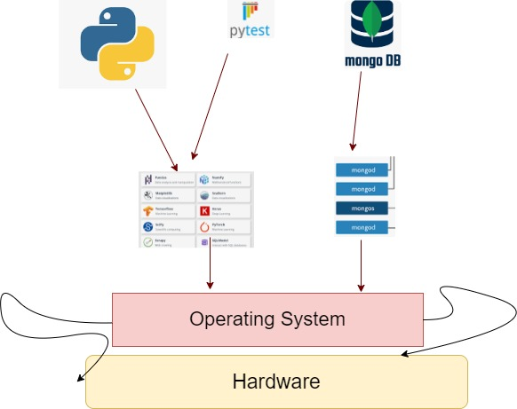
Introduction
Complex matrix of hardware, OS, libraries
New library upgrades, portability across OS
Might not gives always same result, when run on different platform
Different deployments in different environments
Shipping application might run in one and might face issues on other

Slide 3
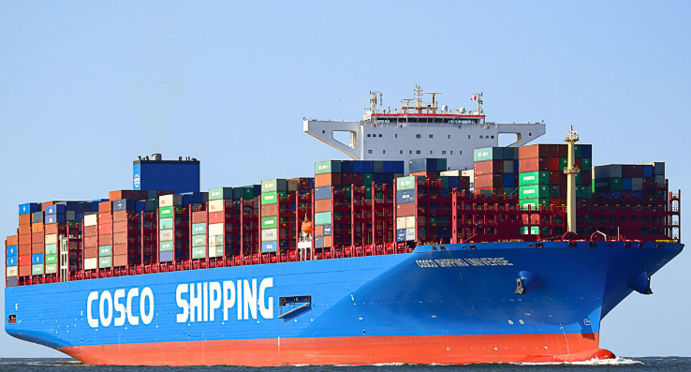
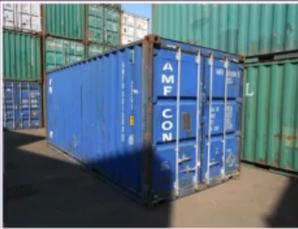
Introduction
Imagine each component runs in its own environment packaged with its own dependencies and libraries. Like containers on ship carrying its own environment
Docker is tool for creating and managing containers
Container is unit packing code with required libraries and runtime
Always gives same result, when run anywhere

Slide 4

Containers vs Vms
VM, though virtual but the spinning and using VM is not that lightweight
Each VM got its own OS and need lot of CPU and memory and disk
Containers are lightweight, low impact on underlying OS
Containers got filesystem, kind of Linux
Requires minimum disk space
Boot up time for VM is higher as it need to boot entire OS
Sharing, Re-building and distribution is easier

Slide 5
Installation and tools - WSL
The encapsulation happens in something called as images
Storing, finding and sharing these images can be done by a service, called as Docker Hub ( A service provided by Docker)
Create an account on https://login.docker.com/, its free
For building and containerizing applications, an opensource containerization technology is used called as Docker Engine
Installation steps
sudo apt-get update
sudo apt-get upgrade
Follow - https://docs.docker.com/engine/install/ubuntu/ (There is script also which install everything on same page)
sudo systemctl enable docker
sudo systemctl enable docker.service
sudo systemctl enable containerd.service
sudo usermod -aG docker ${USER}
sudo groupadd docker
sudo gpasswd -a $USER docker
newgrp docker
restart system
If there is issue like Host not installed (or booted) with system, the please follow instructions on next page
Notes:
Or following 2 command –
curl -fsSL https://get.docker.com -o get-docker.sh
sudo sh get-docker.sh
After this follow instructions to run as non root user
And then the steps
sudo systemctl enable docker
sudo systemctl enable docker.service
sudo systemctl enable containerd.service
sudo usermod -aG docker ${USER}
sudo groupadd docker
sudo gpasswd -a $USER docker
newgrp docker
-----------------------------------
sudo systemctl enable docker
sudo systemctl enable docker.service
sudo systemctl enable containerd.service
sudo systemctl status docker.service
sudo systemctl status docker
sudo systemctl start docker
sudo service docker start
If you face some issue like Host not started with system and all , Follow from link
https://forums.docker.com/t/wsl-cannot-connect-to-the-docker-daemon-at-unix-var-run-docker-sock-is-the-docker-daemon-running/116245
The STEPS as –
sudo update-alternatives --config iptables Enter 1 to select iptables-legacy sudo service docker start

Slide 6
Installation and tools
sudo update-alternatives --config iptables
(Enter 1 to select iptables-legacy)
sudo service docker start
Docker Engine consists of a server which runs docker (daemon), APIs to interact with docker daemon and a cli client which is docker
Docker Playground - https://labs.play-with-docker.com/
Notes:
sudo systemctl enable docker
sudo systemctl enable docker.service
sudo systemctl enable containerd.service
sudo systemctl status docker.service
sudo systemctl status docker
sudo systemctl start docker
sudo service docker start
If you face some issue like Host not started with system and all , Follow from link
https://forums.docker.com/t/wsl-cannot-connect-to-the-docker-daemon-at-unix-var-run-docker-sock-is-the-docker-daemon-running/116245
The STEPS as –
sudo update-alternatives --config iptables Enter 1 to select iptables-legacy sudo service docker start

Slide 7
Demo
Docker containers are created out of docker images
Images are kind of blueprint, code, libraries packed with instructions to create container
Images are stored in repositories; one such default repository is docker - https://hub.docker.com/_/registry
More on images latter, but few docker commands
docker run hello-world -> image will be pulled first time and subsequent execution it will pick from local
docker run -d ubuntu sleep 5000 (run container)
docker exec –it <container_id> bash (enter container)

Slide 8
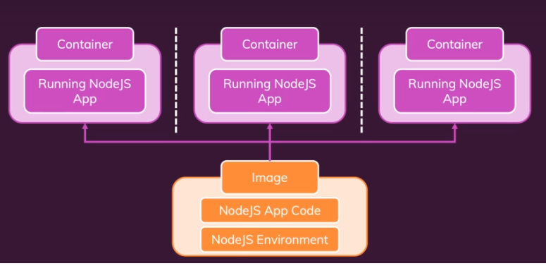
Images and containers
Images are blueprint containing code, runtime, libraries
Container is unit of software, created from image, and are running instances of image
From 1 image, multiple containers can be created on multiple machines and multiple environments
Lot of pre-built images are available like node-js , java, dotnet, ruby
Try docker run -it node and then 1+1
Try docker images, to see latest node js image
Dockerfile can be written to instruct how image can be created (we will see)

Slide 9
Demo
First docker demo –
/py-docker-kubernetes-learnings/ docker_demo
Different versions of same image can exist. The separation of version is indicated by version tag. Following are v1 and v2, versions of same image
cbagade/cl-first-prog:v1
cbagade/cl-first-prog:v2
Default version is latest. (if not specified)
There is no node or library installed on local machine
Other developer can pull and run the image, will run exactly in same manner
docker push cbagade/cl-first-prog:v1
Notes:
How to Open VSCode in Vagrant machine
Bring up vagrant machine
On git bash
vagrant ssh-config
Copy controlplane machine config to some file in some folder like controlplaneconfig.txt
Now on vcCode press F1
Remote-SSH: Open Configuration File
Say new configuration
And paste the file name
Then Ctrl Shift P
Remote-SSH: Connect to Host.
And open default machine

Slide 10
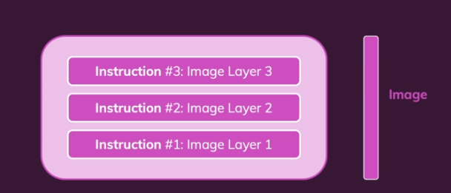
Image layers
Every instruction is represented as layer on image
Each layer is just changes from previous layer and this reflect in size
docker history <image_id>
After a first built, the instructions are cached
When you changes something and rebuild, the instructions are evaluation against cached ones and only changed ones are built again, super-fast
But when a layer is changed, all layers beyond that are re-built
Layers are read-only

Slide 11
DOCKER COMMANDS
docker run hello-world -> image will be pulled first time and subsequent execution it will pick from local
docker run -d ubuntu sleep 5000 (run container)
docker exec –it <container_id> bash (enter container)
docker ps –a -> will list all containers
docker ps -> will list running containers
docker stop <container_id> - stop container (also start) (container_id can be replaced with container name)
docker rm <container_id> - remove container
docker images – list of images
docker rmi <image_name> - remove image from local system (ensure all running container from that image are stopped and removed)
docker pull <image_name> - just download image with container being created

Slide 12
Docker registry
Central repository of all docker images
Docker Hub is docker default registry
py-first-prog → Say an image
library/py-first-prog -> where library is user account
docker.io/library/py-first-prog -> docker.io is default registry
When this image is pushed, it get stored to registry (But as a user we can’t push to library user account, this account is user for all base images)
There are various other registry (private registry AWS , Azure etc)
When user wants to store image, he should create account on docker hub and name his image as
<docker_hub_user>/py-first-prog
docker push <docker_hub_user>/py-first-prog

Slide 13
Demo for json
Docker demo –
/py-docker-kubernetes-learnings/docker_demo_2

Slide 14
concepts
Unlike VMs, containers are not meant to host just OS
Containers are supposed to run some program like python web server or some database
So, some containers are in existed state
If the process is over, then container exit
docker run ubuntu
This command run a ubuntu image and exit as there is no process to run. Ubuntu is an OS
To enter inside container and say execute any command
cat /etc/resolv.conf (run on localhost, outside container)
docker run ubuntu sleep 1000 (sleeps 1000 sec so that container won’t exit)
docker exec <container_id> cat /etc/resolv.conf (prints file inside container)
docker exec –it <container_id> bash (enter inside running container and print same file)
To run container in background or detach mode
docker run –d ubuntu sleep 1000

Slide 15
ENV Vars
app.py in earlier demo got harcoded value for who_to_greet variable
This can be made dynamic and passed as env var
/py-docker-kubernetes-learnings/docker_demo_env
Value for this env var can be passed in docker run command

Slide 16
Managing data

Slide 17
Data inside container
Demo for changing data inside container
/py-docker-kubernetes-learnings/managing_data/data_till_container
The changes made in above demo, do not persist after container is recreated
The changes are happening inside container and not on host

Slide 18
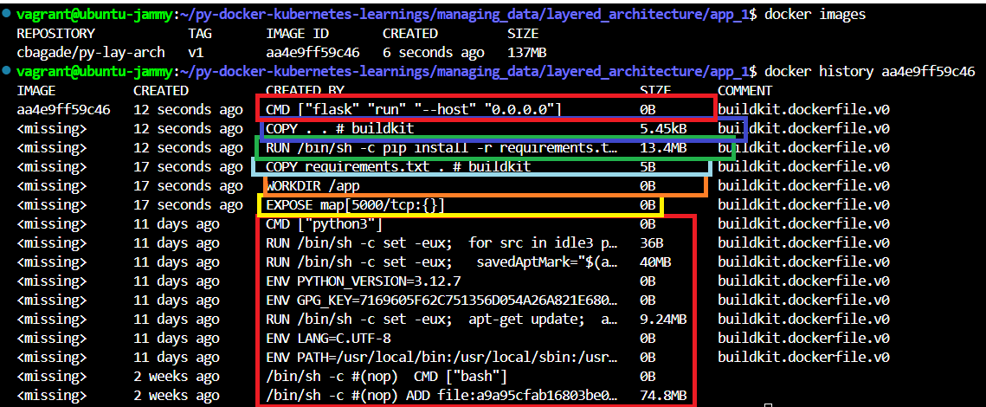
Layered Architecture
py-docker-kubernetes-learnings/managing_data/layered_architecture
There are 2 folders app_1 and app_2 and only diff is the path in app_2-> app.py, having ‘v2’ in path
Follow instructions on respective Dockerfile to build images. Screen shot from build of app_1
The total size of image is 137 MB
Each layer is actually only a change on previous layer.
Expose instruction layer is of size 0 , so this change is on top of base python image
COPY instruction is just 5B and is only change on previous layers
So, building of docker images are super fast
If user is changing only app.py and rebuild image, the only layers having app.py instruction onwards will be built, so user should try to write static instructions at same level

Slide 19
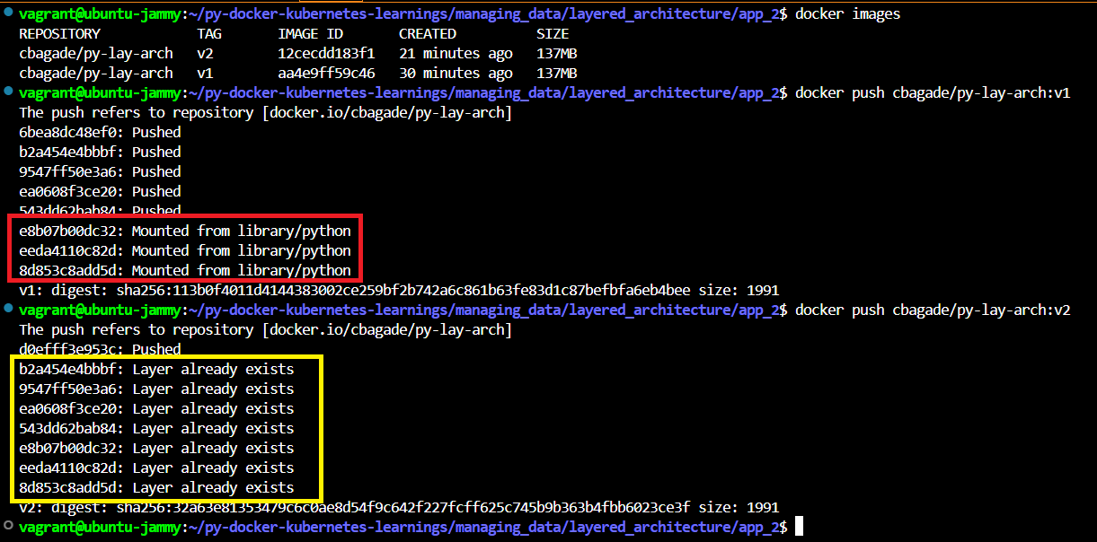
Layered Architecture Cont.
Build image in app_2 folder and push both the images in order of app_1 and app_2 , to docker registry
During first image push, the registry is using layers from existing base image
During second image push , the layers from first image are used and only changes are pushed.
Not everything is pushed, only the changes are pushed and anything preexisting is reused.
That’s why building/pushing docker images is superfast process

Slide 20
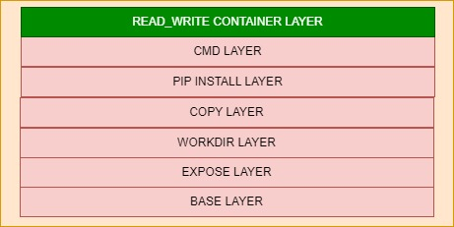
Layered Architecture Cont.
Docker images layer are read-only, once image is formed, the layers can’t be modified
These layers can only be modified by initiating new build
If these layers are read-only, how come we able to write some data with POST in last example
When a container is created out of image, docker created a new writable layer, on the top of all layers, called as container layer
The POST data in last example is stored on this writable layer
This layer exist till container exist, when container is gone, this layer is gone and hance changes in previous examples are gone

Slide 21
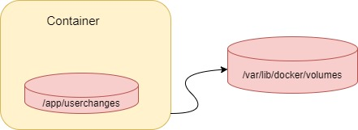
Volumes – Persist data
Container are short lived. The data inside container can be mounted outside container, on to the host to persist the data
Volumes are some folders on your host which are mounted on containers
Helps to persist data
Volumes are like connection between folders, outside and inside of container
Volumes are not affected by container shutdown

Slide 22
Anonymous volumes
The volume will be a directory on local host, mounted on container
The changes made to the files inside mounted directory, will be reflected on host
The anonymous volume can be mounted inside Dockerfile as
VOLUME [ "/app/userchanges" ]
The mounted volume on container, will be available on host but the directory on host is controlled by docker system
This volume has no name and controlled by docker system, hence called as anonymous volume
/py-docker-kubernetes-learnings/managing_data/anonymous_volume
The volume is gone with container and can’t survive container restart

Slide 23
Anonymous volumes – Use cases
Short lived containers , temporary storage , can store command output
Test data can be stored, like to experiment with something with DB without persistent storage (can mount db volumes)
Mostly non persisting data

Slide 24
Named volumes
The volume will be a directory on local host, mounted on container
The changes made to the files inside mounted directory, will be reflected on host
The named volumes can be mounted while running docker run command
The mounted volume on container, will be available on host but like anonymous volumes the directory on host is controlled by docker system
\py-docker-kubernetes-learnings/managing_data/named_volume
But this volume survives container restart

Slide 25
Named volumes – USE CASES
Persistent data like databases, file server
Can be mounted on diff containers and hence can share data
Backup of data , since data is available after container is stopped

Slide 26
Bind Volumes
User specify a directly on host to be mounted on container
The changes made to the files inside mounted directory, will be reflected on host
Not to be used on production, only for local testing
\py-docker-kubernetes-learnings\managing_data\bind_volume
This volume survives container restart
Use case can be putting entire code to a bind vol so that code changes can be made inside container and tested
Only use for dev and not production

Slide 27
BIND volumes – USE CASES
Sharing files between host machine and containers
Can share source code or build artifacts, so as to test changes fast. Only for development purpose.

Slide 28
networking

Slide 29
Container communication
OOB container can make request to outside world
\home\chandra\docker-kubernetes-learnings\networking\www
Cross container communication
Demo shows communication with mongo container, this demo will have ip of mongo container hardcoded in app.js
\home\chandra\docker-kubernetes-learnings\networking\cross_container\ip_hardcoding
If containers are created on same network, then these can communicate with names
\home\chandra\docker-kubernetes-learnings\networking\cross_container\container_name
\home\chandra\docker-kubernetes-learnings\networking\cross_container\persisting_data

Slide 30
Docker compose

Slide 31
Docker compose
Till now, we created all pods, volume, networks with command line and we also deleted those with command line
This is cumbersome when there are lot many containers and artefacts
docker-compose is tool, which makes managing multi-container setup easier
docker-compose helps to replace ;docker build and docker run’ commands with one configuration file
docker-compose does not replace Dockerfile, Images or Containers
docker-compose file is composed with yaml syntax
\home\chandra\docker-kubernetes-learnings\dockercompose\mongocompose
\home\chandra\docker-kubernetes-learnings\dockercompose\app_by_compose
By default, everything inside docker-compose file will be created in one network
Notes:
sudo apt install jq
VERSION=$(curl --silent https://api.github.com/repos/docker/compose/releases/latest | jq .name -r)
echo $VERSION
DESTINATION=/usr/bin/docker-compose
sudo curl -L https://github.com/docker/compose/releases/download/${VERSION}/docker-compose-$(uname -s)-$(uname -m) -o $DESTINATION
sudo chmod 755 $DESTINATION

Slide 32
miscellaneous

Slide 33
Misc
Execute command in running container
docker exec executes command in a running container
Helpful for debugging
docker exec –it <container_id> cmd (docker exec –it <container_id> ls docker exec –it <container_id> pwd docker exec –it <container_id> /bin/bash )
CMD and ENTRYPOINT
\home\chandra\docker-kubernetes-learnings\misc
Prefer ENTRYPOINT and CMD
Can be used in combination, ENTRYPOINT will set the entry command to container and CMD will provide default arguments, which in case can be overwritten

Slide 34
kubernetes

Slide 35
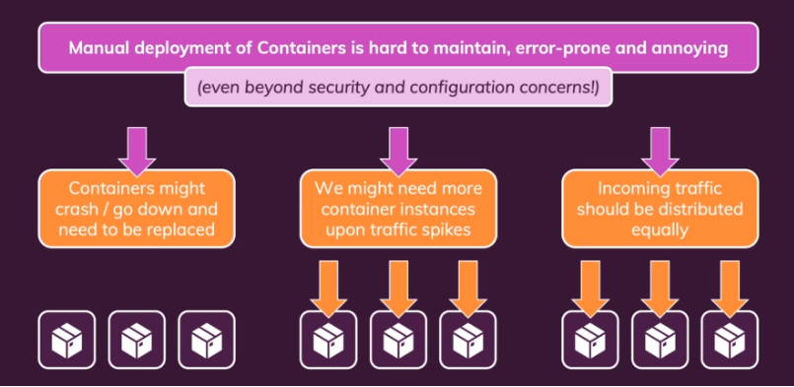
Manual deployment
A scenario for manual deployment of containers and managing those
Impossible

Slide 36
Kubernetes (k8)
Kubernetes is container orchestration tool, which facilitates large scale deployment of containers
Opensource and independent of any cloud provider
It automates deployment, scaling and management of containerized applications
It is NOT a cloud service provider, or a service provided by cloud service provider
Its is NOT restricted to any cloud
It is NOT replacement for docker but works with docker to deploy and manage containers at large scale
It’s a free service, but cloud providers also provide managed k8 services which are paid like Elastic Kubernetes Service (EKS) by AWS and Azure Kubernetes Service (AKS) by Azure
Smallest deployable unit is pod

Slide 37
K8 Terminologies
Kubernetes can be installed on physical or virtual vm and called as Node
There are 2 types of nodes involved – controlplane and worker nodes
Container are launched on worker nodes and real setup will have multiple nodes
Kubernetes cluster involved all the nodes and is managed by controlplane node, also called as master node
There is a standard established for managing containers and is called as container runtime interface (CRI)
ContainerD is one such open-source container runtime that implements CRI and manages containers and container images on a host system
Docker exists even before CRI came in and docker doesn’t support CRI
Kubernetes decided to support runtimes, that implement CRI and since docker doesn’t implement CRI, support for docker is removed from Kubernetes as container runtime. But images created by docker are supported by Kubernetes
To work with CRI such as ContainerD we need tool. There are many like ctr (not so user friendly), nerdctl etc., In our case we will use crictl (from Kubernetes community)
kubelet will interact with CRI to create containers but for humans' interaction crictl is used (mostly for debugging)
Try sudo crictl images on controlplane terminal (mostly commands will be similar to docker)

Slide 38
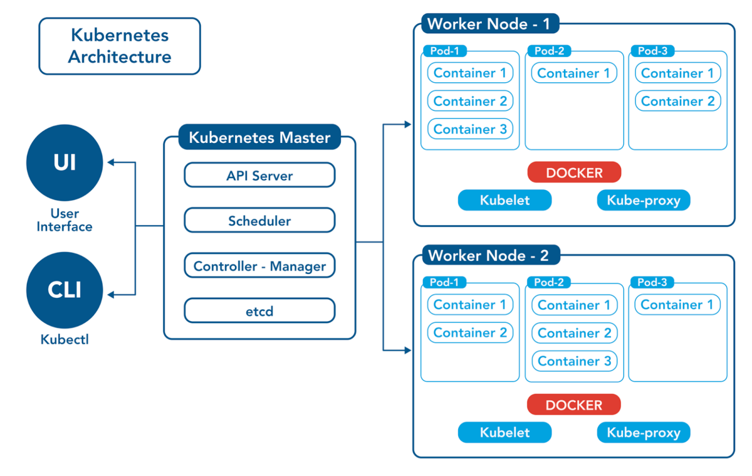
K8 Architecture
Notes:
A k8 cluster majorly consist of 2 types of machine –
Master
Worker
Master takes care of management of worker. We will come to master later on, lets first discuss worker.
When you deploy pods on to k8, those are run on worker machines, called as worker nodes. There can be many workers node based on application demand and growth.
The lifecycle of pods, like when it should be created, which worker node it should be created, when it should be taken out of service is all controlled by k8 infrastructure. K8 adds more CPU, memory to pods when require. They scale out the pods, when require.
Kube proxy on worker node, maintains network services, like traffic routing, communication between pods.
Kubelet, run on worker node and coordinates the work of creating and destroying containers according to configuration information stored on master
Kubelet communication state and health of containers to kubernetes. Like if pod require more resources or it is failing and need to bring up.
Master is also called as Control Plane and it controls the worker nodes. It consists of –
Etcd – Stores overall configuration data of cluster (state and details of pods). We will learn about configuration data and how to make it available to Pods.
API Server – The interfaces to k8. The user and also the internal components uses these APIs to interact with k8. API Server is responsible to facilitates the communication via k8 apis.
Schedular – Schedules the pod on worker node. It decide which node to put the containers based on worker node resources, policies and other factors
Controller Manager – Responsible for bringing current state to desired state. Like say, Pods required are 4 and now are 3, so this component is responsible to trigger scheduling of one more pod. It decides what action to take when node goes down. When a new project is created, those require some default entities like Service Accounts. Controller Manager creates those.
Kubectl is CLI to interact with k8 APIs.

Slide 39
K8 Architecture
kubectl get nodes
kubectl get pod –n kube-system
Notes:
A k8 cluster majorly consist of 2 types of machine –
Master
Worker
Master takes care of management of worker. We will come to master later on, lets first discuss worker.
When you deploy pods on to k8, those are run on worker machines, called as worker nodes. There can be many workers node based on application demand and growth.
The lifecycle of pods, like when it should be created, which worker node it should be created, when it should be taken out of service is all controlled by k8 infrastructure. K8 adds more CPU, memory to pods when require. They scale out the pods, when require.
Kube proxy on worker node, maintains network services, like traffic routing, communication between pods.
Kubelet, run on worker node and coordinates the work of creating and destroying containers according to configuration information stored on master
Kubelet communication state and health of containers to kubernetes. Like if pod require more resources or it is failing and need to bring up.
Master is also called as Control Plane and it controls the worker nodes. It consists of –
Etcd – Stores overall configuration data of cluster (state and details of pods). We will learn about configuration data and how to make it available to Pods.
API Server – The interfaces to k8. The user and also the internal components uses these APIs to interact with k8. API Server is responsible to facilitates the communication via k8 apis.
Schedular – Schedules the pod on worker node. It decide which node to put the containers based on worker node resources, policies and other factors
Controller Manager – Responsible for bringing current state to desired state. Like say, Pods required are 4 and now are 3, so this component is responsible to trigger scheduling of one more pod. It decides what action to take when node goes down. When a new project is created, those require some default entities like Service Accounts. Controller Manager creates those.
Kubectl is CLI to interact with k8 APIs.

Slide 40
installation
For dev , setup can be done with minikube, KinD (Kubernetes in Docker)
Playground - https://killercoda.com/playgrounds/scenario/kubernetes
Cloud providers provides managed k8 services like EKS, AKS
KinD installation on Ubuntu (WSL)
sudo curl -L "https://kind.sigs.k8s.io/dl/v0.18.0/kind-$(uname)-amd64" -o /usr/local/bin/kind
sudo chmod +x /usr/local/bin/kind
kind get clusters
kubectl installation on Ubuntu (WSL)
curl -k -LO https://storage.googleapis.com/kubernetes-release/release/v1.27.1/bin/linux/amd64/kubectl
sudo chmod +x ./kubectl
sudo mv ./kubectl /usr/local/bin/kubectl
kubectl version --short
Notes:
kind delete cluster -> will delete cluster kind
kind delete cluster --name chandra-learnings -> will delete cluster chandra-learnings
On powershell (admin)
wsl --shutdown
wsl --list --verbose
To start
wsl -d Ubuntu-22.04

Slide 41
installation
Create kind cluster (WSL ubuntu)
cd \home\chandra\docker-kubernetes-learnings\kubernetes_demos
kind create cluster --config=cluster-config.yml --name=chandra-learnings
If there are issues like, kubelet not healthy then follow –
On ubuntu - echo -e "[boot]\nsystemd=true" | sudo tee /etc/wsl.conf
On powershell (admin) ->
wsl --shutdown
wsl --list --verbose
wsl
exit from powershell and log onto ubuntu – and create cluster again
Restart machine will shutdown kind cluster
docker ps –a
restart container of kind image
Nodes – Display master and worker nodes
kubectl get nodes

Slide 42
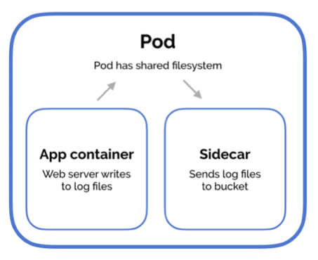
Containers and poDs
Containers consist of application and all the libraries and dependencies required to run the application, packaged as single software unit
K8 does not deploy containers on worker nodes, but encapsulate in an K8 object called as Pod
Pod is smallest deployable unit of computing, that is created and managed in k8
Pod is group of one or more containers, with shared storage and network resources
A new pod can be created to server more requests and thus multiple instances of same application can run simultaneously
K8 can schedule pod on any worker node
Pod mostly got 1-1 relation to container inside, but pod can have multiple containers (like helper container)
If pod is holding multiple containers, then they can communicate with each other by localhost, since they share same network space. They share same storage space as well.
Pod are ephemeral in nature, meaning stateless, K8 will stop, start replace them when needed
IP changes every time, when a pad is restarted
(

Slide 43
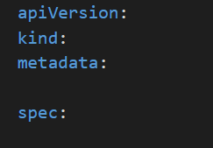
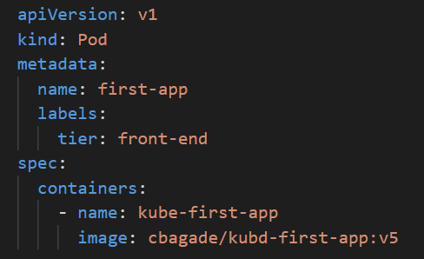
poDs with yaml (declarative approach)
K8 uses yaml as input for creating various K8 objects as Pod.
The yamls follow a similar structure. A K8 definition file contains 4 top level fields as shown ->
apiVersion – Version of K8 API (v1, apps/v1 and others)
kind – type of object say Pod (and others)
metadata – data about the object like its name, labels etc., Unlike first 2 fields, metadata is dictionary and contains key value pair
spec – contains container information, to be wrapped inside pod and spec is dictionary. The containers inside spec is list or array and denoted by – (hyphen) (can have more containers)
kubectl create –f file.yaml will create pod
kubectl describe pod <pod_name> - all information about pod
Refer yaml file at -
\py-docker-kubernetes-learnings\kubernetes_demo\declarative_approach\pod.yaml
Follow instruction in yaml file to create pod

Slide 44
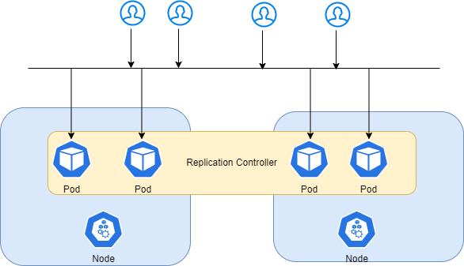
k8 controllers (replication controller and Replicaset )
Controllers are processes which observe k8 objects and respond accordingly
Replication controllers replicates and provision multiple pods, providing high availability and shares load
Even in case of single pod, replication controller will bring new pod automatically, if pod fails, ensuring specified number of pods are running, always
Pods can scale on different nodes , helping in load balancing the load across nodes and pods
There are 2 similar terms , Replication Controller and Replica Set
Replication Controller is old and is replaced by Replica Set

Slide 45
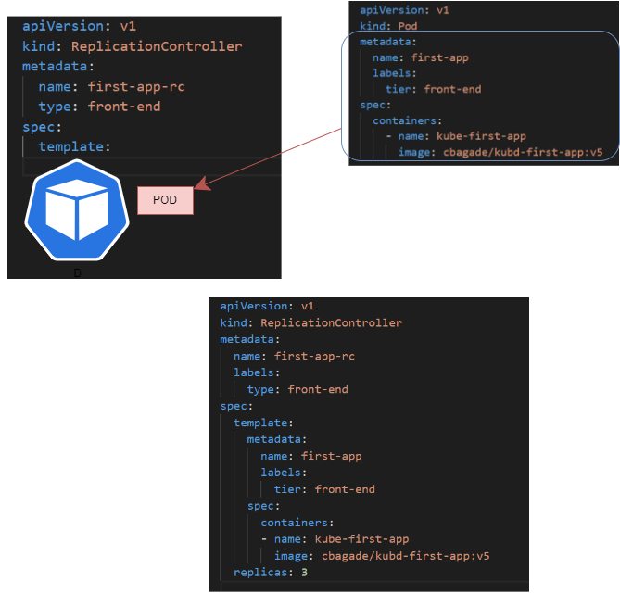
Replication controller (RC)
The yaml file got top 4 elements – apiVersion, kind, metadata, spec
spec – contains template of pod to be created by RC. Move pod yaml content from metadata as children of template in RC yaml file
spec also contains, replicas – number of pods to be created
There are 2 metadatas- 1 for RC and 1 for Pod
There are 2 specs – 1 for RC and 1 for Pod
Refer yaml file at -
\py-docker-kubernetes-learnings\kubernetes_demo\
declarative_approach\replication_controller.yaml
Follow instruction in yaml file

Slide 46
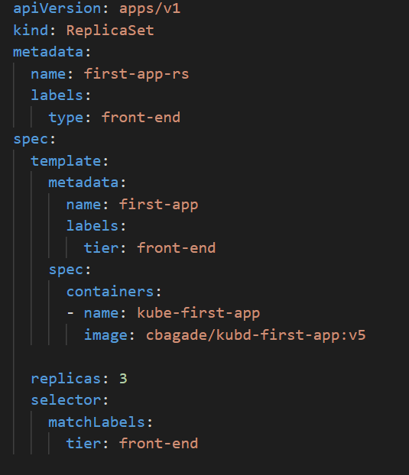
Replica Set (RS)
The yaml file got top 4 elements – apiVersion, kind, metadata, spec (apiVersion differs to RC)
spec – contains template of pod to be created by RC. Move pod yaml content from metadata as children of template in RC yaml file
spec also contains, replicas – number of pods to be created
In addition to top 4 elements, the definition also contains, a selector element
selector match labels of pods, to manage via ReplicaSet, with help of labels
and selectors, RS manages pods
ReplicaSet can also manage pods, which are NOT defined as part of its own
definition file (matching labels) [RC can also have optional selector, when not
defined its implicit what defined on pod template]
In case say RS need to manage pods created outside its yaml. It does this with
Labels/Selectors, but inline template is still required because in case pod
goes down, ReplicaSet need template to bring up pod to a desired number
Refer yaml file at -
\py-docker-kubernetes-learnings\kubernetes_demo\
declarative_approach\replica_set.yaml
Follow instruction in yaml file

Slide 47
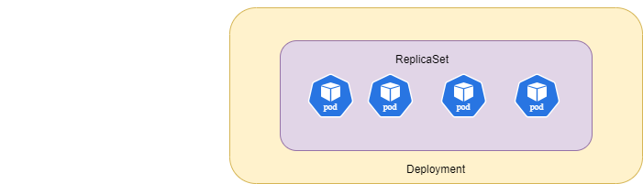
Deployment
A kubernetes object, which governs how to create instances of pods
It helps with scaling, rolling out new versions seamlessly (can do without affecting clients) and rollback if needed
It can create and maintain desired number of replicas for pods
A kubernetes artifacts higher up than replica set, which governs how to create instances of pods
Creating deployment automatically creates replica-set, which manages the desired number of replicas of underlying pods
The content of deployment yaml is same that of replica-set yaml, except kind is ‘Deployment’
Refer yaml file at -
\py-docker-kubernetes-learnings\kubernetes_demo\declarative_approach\deployment.yaml
Follow instruction in yaml file
To see objects
kubectl get deployments
kubectl get rs
kubectl get pods

Slide 48
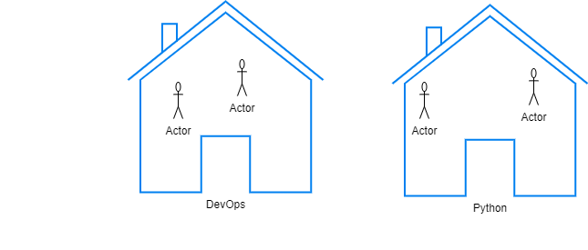
Namespace - isolation
Namespace – Mechanism to isolate groups of resources within cluster
All objects in kubernetes resides in namespaces, at moment you are creating in default namespace which k8 creates by default
Kubernetes creates some namespaces for it internal purpose, like kube-system so user won’t delete accidently
User mostly creates namespaces in production env to isolate resources from each other.
While user work in one namespace, he can’t accidently modify resources in another namespace
A limit can be imposed on resources for each namespace, so the consumption won’t increased beyond its quota Say a particular namespace can use 64GB and can consume 16vCPUs
Objects within same namespace can refer each other by name – we will see this latter
To refer objects in another namespace, namespace need to be used - – we will see this latter
Refer -
/py-docker-kubernetes-learnings/kubernetes_demo/declarative_approach/pod_ns.yaml
Notes:
Picture
Students in each class will have access to their own set of resources (tutor, electrical utilities, benches etc.,)
In K8 these are namespaces and all objects within namespaces have access to their own set of resources
They also can reach each other
They also can reach objects in other namespaces but via some mechanism, which we will see latter

Slide 49
DAEMON Set
Same as replica set to ensure multiple copies of pods, but it ensures 1 copy of pod on each node
Useful for use cases like monitoring agent, or kubeproxy
When a new node is added or deleted, daemonset with ensure that the pod will be scheduled accordingly
Refer yaml file at -
\home\chandra\docker-kubernetes-learnings\kubernetes_demo\
declarative_approach\daemon_set.yaml
Follow instruction in yaml file

Slide 50
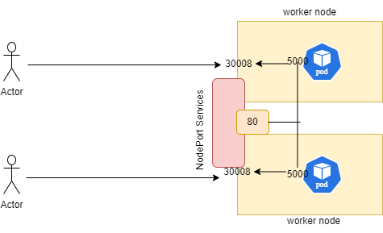
service
\py-docker-kubernetes-learnings\kubernetes_demo\declarative_approach\pod_ip.yaml
This example demonstrate accessing application with pods iP
Imagine a deployment with multiple replicas, having multiple IPs and also pods being ephemeral in nature , the IPs will keep on changing
In such cases, we can’t rely on pods IPs to access the application
There should be some mechanism, which abstract pods IP addresses behind it, while calling the application
Kubernetes Services maintain and hides pods IPs behind it
Pods/Deployments can be exposed by Kubernetes Services and Services maintain IPs of pods without customer need to worry about those
The first type of Service is NodePort Service, which expose application behind worker node IP.
\py-docker-kubernetes-learnings\kubernetes_demo\declarative_approach\service.yaml

Slide 51
Service Types
Service is kubernetes artifacts and it will listen to request on port on node. On Receiving request, it will fwd request to pod on port where application is running
Service will map its port to a target port on pod. Also, on node it will listen on a node port.
Service will forward traffic on node port to the application.
Such service is called as NodePort service –
Also, pods are ephemeral in nature, IP keeps on changing. Service will select pods with labels and internally discover Ips of pods to map with
NodePort values range – 30000 to 32767
If pods are on different nodes, then service spans the node to select pods with matched labels and can be accessed with same node port (though across nodes). This service is kind of inbuilt load balancer
ClusterIP – Reachable from within cluster. Creates a virtual IP within cluster for services to enable communication, say between frontend and backend servers. This is default type of all services.
Load Balancer – Provision a load balancer in supported cloud providers (AWS, Azure, etc.,) . It distribute loads.
With services, microservices communication is established. Each pod can scale independently without any impact on caller.

Slide 52
Deployment Strategies
When a deployment is created a new rollout is triggered, which creates a new deployment revision
The application might go through upgrade, which attracts new deployment to be rolled out , to new revision
Now all the revisions are maintained by Kubernetes in case if required to rollback to previous version
\py-docker-kubernetes-learnings\kubernetes_demo\deployment_upgrades/recreate_rolling/app_deployment.yaml
There are 2 types of deployment strategies –
Recreate - Destroy all pods and recreate, this will cause downtime when all pods are down, and new pods are yet to come up
Rolling Update - Take down older version and bring up newer version one at a time, this way there is no downtime, this is default strategy
The application might go through upgrade, which attracts new deployment to be rolled out , to new revision
Blue Green Deployment – Traffic to be moved to new environment without disruption
In Blue Green deployment the newer environment runs with old environment. Users must be shifted to newer version without downtime. This is release mgmt. strategy
If Green env got some issues , users can be shifted back to older one
\py-docker-kubernetes-learnings\kubernetes_demo\deployment_upgrades/blue_green/blue_deployment.yaml
Canary Deployment – Here a new version is released, and small amount of traffic is routed to new version.
Canary is for testing new versions, once version is tested , all traffics can be routed to newer version, decommissioning older version. (It doesn’t have 2 envs as blue-green)
Example can be executed in similar fashion, as what is explained in blue-green
Istio is service mesh and can tell how much % of traffic is routed (out of scope)
Notes:
If calico pods give error –
vagrant halt
vagrant up

Slide 53
Containers and poDs (imperative way)
Almost majority of k8 artifacts created in declarative fashion, can be created with command line
\py-docker-kubernetes-learnings\kubernetes_demo\confirm_setup
(

Slide 54
Imperative vs declarative
Imperative -
kubectl (run create expose edit scale set delete) (either command or yaml with if option)
Create Objects – run/create object
Update Objects – edit scale set
Used once while objects are created
Commands get complex as application grows
Say an object is created with ‘kubectl create yaml’ command and definition is edited with ‘kubectl edit’ command, then changes are deployed, but changes are not persisted in yaml
docker build –t cbagade/kubd-first-app:v5.1
docker push cbagade/kubd-first-app:v5.1
kubectl create –f pod.yaml
kubectl edit pod <pod_name> and change image to new version and save. The original yaml is not changed, though pod is updated with new image
Declarative – look at existing configuration and figure out what changes to be made to the system
kubectl apply –f (If object doesn’t exist, is created)
With yamls, we know how the objects looks like (to refer again)
The original yamls and be changed and applied repeatedly

Slide 55
Command and Entrypoint
This is already covered from docker perspective
py-docker-kubernetes-learnings/kubernetes_demo/misc/cmd_ep_demo/Dockerfile
From kubernetes perspective -
py-docker-kubernetes-learnings/kubernetes_demo/misc/cmd_ep_demo/pod.yaml

Slide 56
Kubernetes env vars
This is already covered from docker perspective
py-docker-kubernetes-learnings/kubernetes_demo/misc/env_demo/Dockerfile
From kubernetes perspective -
py-docker-kubernetes-learnings/kubernetes_demo/misc/env_demo/pod.yaml
There are other ways to pass env vars to pod/deployment, we will see latter

Slide 57
Managing configurations - configmaps
From kubernetes perspective, passing env vars to pod is covered at -
/py-docker-kubernetes-learnings/kubernetes_demo/misc/env_demo/pod.yaml
If there are more env variable in pod yaml, it will be messy and difficult to manage
Kind configmap is k8 artifact, which manages env variable centrally
Mostly the data which should be decoupled from application code, is configured in configmap
configmap pass env variables in key value pairs
During pod creation, inject configmap in pod, so the key value pairs defined therein, are available inside pod as environment variables
/py-docker-kubernetes-learnings/kubernetes_demo/k8_configurations/config_map/pod.yaml
/py-docker-kubernetes-learnings/kubernetes_demo/k8_configurations/config_map/pod_2.yaml

Slide 58
Managing configurations - secrets
configmap stores data in plain text format and so its not good idea to store sensitive information like password in configmap
Kubernetes secrets are used to store sensitive information
Again, secret pass env variables in key value pairs
During pod creation, inject secret in pod, so the key value pairs defined therein, are available inside pod as environment variable
Data inside secret is stored in encoded format
While these values are retrieved in pod, they are automatically decoded
Secrets are only encoded, not encrypted, so don’t push your secret values to git-hub
Data to be encoded might contain unrecognized or special characters, so better to encode those
Better way to store secret is at safe vault like AWS secret manager or Key Vault and convert to kubernetes secret at runtime (out of scope)
Secrets when stored in ETCD can be encrypted
/py-docker-kubernetes-learnings/kubernetes_demo/k8_configurations/secrets/pod.yaml
/py-docker-kubernetes-learnings/kubernetes_demo/k8_configurations/secrets/pod_2.yaml

Slide 59
Security – security context
By default, the application inside pod gets executed with root privileges
But this root used don’t have all the capability as that of OS root user. Also, the capabilities can be assigned as required
Also, having container running with root privileges is dangerous
In case of hacking, hackers will have access to all directories and can execute some dangerous commands
To prevent this Kubernetes provide one construct called as SecurityContext
User can provide instructions to run pod with non root user
/py-docker-kubernetes-learnings/kubernetes_demo/security/security_context

Slide 60
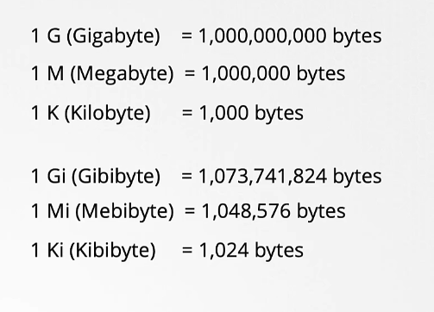
Resource requirements
Scheduler schedule pod on a node where enough resources are available
The pod consumes resources on that node
In case enough resources are not available, pod will be in pending state – refer -
\py-docker-kubernetes-learnings\kubernetes_demo\resource_reqt\pod.yaml
resources – requests – the values are guaranteed to be allocated to pod
CPU value can be 1 (count) or more. When its 0.1 its 100m ((milli)core) and you can go low till 1m
Memory can be, say 256Mi (Mebibyte)
If no resource are specified, by default container can consume as much
resources as it required, and can suffocate other pods
This can be avoided by setting limits, container will be limited then
If a pod, try to consume more cpus than its limits, it is throttled
If a pod try to consume more memory than its limits, constantly,
the pod will be terminated (OOM error)

Slide 61
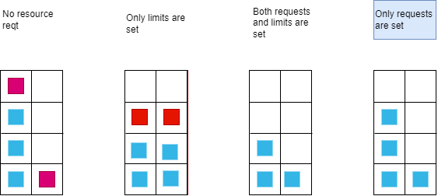
CPU/memory behavior - Resource requirements
Notes:
From Fig , The node is having 4 vCPUs
With No Resource Reqt Specified – 1 pod can consume all available resource and can suffocate other pod
Only Limit is Set – So K8 auto set Request = Limits
Now say pods are specified to have 3 vCPUs as limit then again resource would be issue as both pods will be guaranteed to get, but nodes don’t have that
So for both 2nd second block its green, but 3rd block is red
Both request and limits are set
Say pod 1 and pod 2 are having 1 as requests and 2 a limits, So they get what is specified,
but imagine pod1 need more vCPUs for some reason , and CPUs are available, but since the limits are specified, pods can’t go beyond limits
Only request is set – Same scenario as last one and this time, pods can get , if needed and vCPUs are available
But at any point , pod 2, is guaranteed to get what is requested and in such cases if pod1 needed more than limit , then it is throttled
Most Ideal scenario.
Same behaviors exist for memory.
In last case in case pod2 needed its guaranteed memory and pod1 is consuming more than limit , then it need to be killed.

Slide 62
Resource requirements – Limits and quotas
Default values can be set on pods - refer
\py-docker-kubernetes-learnings\kubernetes_demo\resource_reqt\limit_range.yaml
These will be set at namespace level
Quotas can also be set which will governs resources consumed by all pods at namespace level – refer -
\py-docker-kubernetes-learnings\kubernetes_demo\resource_reqt\resource_quotas.yaml

Slide 63
Taints and tolerations
Consider an institute which conduct sessions on various courses. These courses are not free, and only paid members are allowed
In terms of topic under discussion, the taints are kind of monetary charges for sessions, and paid members are kind of tolerant and can attend sessions
Imagine a scenario where a particular node have resources available for frontend pods only (no mongo pods are allowed)
By default, scheduler will schedule all sort of pods based on resource reqt
But for this case, we can prevent mongo pods getting scheduled on this node by tainting the node
And only frontend pods are preferred to get scheduled on this node, this can be achieved by applying tolerations on frontend pods
\py-docker-kubernetes-learnings\kubernetes_demo\pod_placement/tains_tolerations/pod.yaml
Tains-Tolerations are for restricting pods to be placed on some node, but pods are not guaranteed to be placed on tainted node, if other nodes are available and are taint free
Say there are 2 nodes and 2nd node is not having any taint , so the pod with some toleration can be placed there also
But it's guaranteed that pods that don’t tolerate taints, won’t be placed. Taints and Toleration works more in favor of rejection than scheduling

Slide 64
Node selector
Helps to place a pod on desired node
Say a pod need fairly large number of resources and need to be placed on node with larger capacity
Imagine a scenario where a particular node have resources available for frontend pods and all frontend pods are desired to scheduled there
\py-docker-kubernetes-learnings\kubernetes_demo\pod_placement\node_selector\pod.yaml

Slide 65
Node affinity – complex requirements
To satisfy complex requirements such as place pods on this node or that node or don’t place pod on this node
Advanced capabilities but more complex
Imagine a scenario where a particular node have resources available for frontend pods and all frontend pods are desired to scheduled there
\py-docker-kubernetes-learnings\kubernetes_demo\pod_placement\node_affinity\pod.yaml
Taints and Toleration will ensure to reject pods which does not tolerate taints and if this is combined with node affinity, it will ensure that pods are scheduled on desired node

Slide 66
Readiness probe
There are certain application which takes longer to warm up and being stable like databases, Jenkins etc.,
The containers might be in Ready state, but applications may be still warming up
In that case any request to that Pod, won’t be able to get fulfilled as application is not yet Ready to fulfill requests
Service would start sending traffic to pod, as soon as Kubernetes marks it as Ready and user might face service disruption
Readiness Probe is a mechanism which helps to determine if application is Ready
Based on application, developer can code the application readiness
With readiness probe , service will only send traffic to pods, once reediness probe confirms that
\py-docker-kubernetes-learnings\kubernetes_demo\monitoing\readiness_deployment.yaml

Slide 67
Liveness probe
Kubernetes orchestrator will try to restart the container, if it crashes.
But what if, there is a bug in code which makes application not to work, but container stays alive
In such case container is up, but the users are not served, this will need container restart
Liveness probe can be configured to check if application within the container is healthy, in case if its not healthy, the container is restarted
This is useful in deadlock situation or a bug in system to keep application running (which eventually need to be corrected)
\py-docker-kubernetes-learnings\kubernetes_demo\monitoring\\app_deployment_liveliness.yaml

Slide 68
Jobs and cronjob
Till now, we seen the workloads that are long terms, like running applications
There can be certain workloads, which can exist for shorter duration like running come computations or reports
Normal pod with such 1-time task – refer
\py-docker-kubernetes-learnings\kubernetes_demo\jobs\pod.yaml
Mostly pods are for continuous running application or process, for one time activity there is job
\home\chandra\docker-kubernetes-learnings\kubernetes_demo\jobs\job.yaml
Like Linux cronjob concept. CronJob is a job which can be scheduled
\home\chandra\docker-kubernetes-learnings\kubernetes_demo\jobs\cron-job.yaml

Slide 69
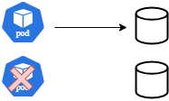
Kubernetes volumes
Changes, without Volume
This demo make temp changes to a file, but all are localized inside container.
Can’t survive container or pod restart
\py-docker-kubernetes-learnings\kubernetes_demo\k8_with_volumes\without_volume
Idea is to persist data in some volume, so even if pods dies, volume and data remains

Slide 70
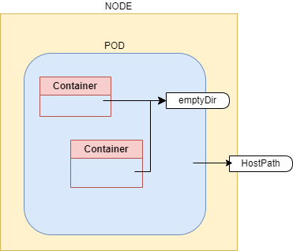
Kubernetes volumes
emptyDir
Creates an empty directory on pod when pod starts and keep alive till pod is alive
Kind of temporary folder created, when pod starts
As name suggest it is initially empty
Can survive container restart, but can’t survive pod restart
\py-docker-kubernetes-learnings\kubernetes_demo\k8_with_volumes\empty_dir

Slide 71
Kubernetes volumes
hostPath
Mounts a file/directory from node’s filesystem into the pod
Can survive container restart and pod
Won’t work on multi-node cluster
\py-docker-kubernetes-learnings\kubernetes_demo\k8_with_volumes\host_path

Slide 72
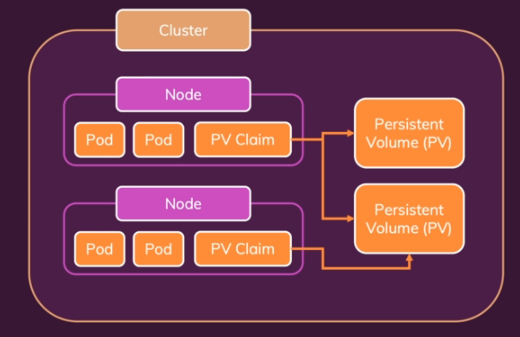
Persistent volumes (PV and PVC)
Pod and Node independent volumes are needed
The volumes we visited would require changes in k8 artifacts like deployment yaml, in case of any change on volume method
We need something which manage storage centrally
Persistent volumes are kubernetes entities like pod, deployment
There are independent of pods and nodes and create by administrator and users carved out from those storages and use on their deployments
PV can store data on NFS, Cloud, External Storages etc.,
When pods need PVs, they need to raise a claim, called as Persistent Volume Claims (PVCs)
PVCs are then bound to PVs, making PVs available to pod

Slide 73
Persistent volumes (PV and PVC)
PV is abstract and actual storage can come from anywhere like cloud providers (aws, azure, google etc.,) or nfs
To bind PV, there should be a storage class and appropriate driver
kind provides a standard storage class to create volume of type hostPath
Go through Kubernetes Persistent Volume documentation to learn more about storage classes, drivers and various types of storages
PVC will always bind to volume of desired capacity of PV or more
It will be in Pending state till it doesn’t find any suitable PV
\py-docker-kubernetes-learnings\kubernetes_demo\k8_with_volumes\persistent_volume

Slide 74
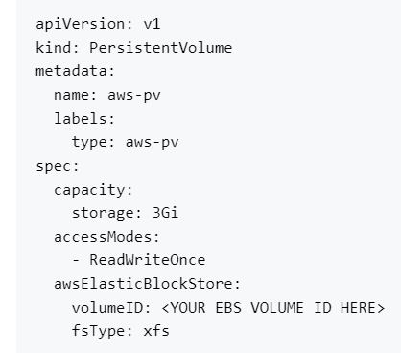
Storage classes
PV definition shown here will store data on AWS EBS
This require the EBS volume of 3Gi, to be created manually on AWS
This is called as Static Provisioning
Storage classes helps to provision volume dynamically when they are needed and is called Dynamic Provisioning
This need a storage class object and PVC should use this storage class object
Storage class would need plugins to create volumes and there are lot available aws, azure, gce, lot others
PVC should specify storage class name in its definition
We don’t need to create PV now, but it will get automatically created
\py-docker-kubernetes-learnings\kubernetes_demo\k8_with_volumes\storage_classes\pod.yaml

Slide 75
networking

Slide 76
Pod internal communication
Containers within pod can communicate to each other by ‘localhost’
\py-docker-kubernetes-learnings\kubernetes_demo\networking\pod_internal

Slide 77
Pod 2 POD communication
Pod to Pod communication can be established either with auto generated service name or DNS
\py-docker-kubernetes-learnings\kubernetes_demo\networking\pod_2_pod

Slide 78
Pod 2 POD - MONGO communication
Following example demonstrate pod-2-pod communication, with mongo db container in place.
\py-docker-kubernetes-learnings\kubernetes_demo\networking\pod_2_pod_with_mongo

Slide 79
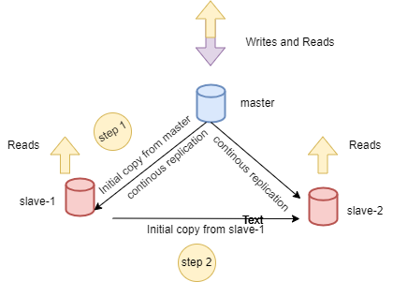
Stateful sets
Picture demonstrate master-slave configuration of any database
To fill initial data in slave-2 , it needs to wait for slave-1 to get copied first
To maintain consistency writes can go to master only and slaves along with masters can serve reads to improve performance
The slaves will store name of master, to maintain cluster and for replication
Consider mapping same scenario to deployment with volumes. All pods of deployment come up at same time, so slave-2 waiting for its initial copy is not possible.
Also to have writes and reads served from different pods, the pods should have respective PVC, which is not possible with deployments
New master pod after getting killed, will have new name. So, slaves can’t rely on pod name
This is where Stateful Sets help. They are all the same as deployment, but differs on few aspects
They come alive in sequential order, after first one is ready and running state next one come alive and this repeats for all pods. Each pod gets ordinal index
This will help slave-2 to get its initial copy from slave-1
The pods get unique name and remains same always, even if get killed, so pods like slaves can rely on these names
Each pod can have its own PVC (if application design demands that)

Slide 80
Stateful sets
If the instances need to come in particular order or need constant names, then stateful sets are needed. It depends on kind of application
Yaml is same as Deployment with Kind: StatefulSet
And require a serviceName (headless)
Scaling StatefulSet, will bring up pods in sequence when earlier pod is in Ready state
While scaling down, the last instance is brought down first. Same applied while termination

Slide 81
Headless service
Stateful set needs headless service
Services are created to access other applications, and they act as load balancer and fwd traffic to application pods
Consider web pod accessing db pods
\py-docker-kubernetes-learnings\kubernetes_demo\networking\statefulset\with_deployment
Master Slave topology need writes to be served master and reads to be served from master and slave. Normal service what we learnt treat all pods similar, so, this requirement won’t be satisfied
If IP address would have fixed, web pod could have used that to write to master, but IP address are not fixed
We need service which does not load balance request but gives us name to connect to each pod. That's where headless service come
Headless service is like normal service expect it doesn’t not balance traffic but gives a unique and constant name to pod to access it
The headless service consist field clusterIP: None and name of service is specified in stateful set to connect to pod with name (DNS resolution)
Note how the MONGO_ADDRESS_WRITE and MONGO_ADDRESS_READ in app_deployment.yaml
\py-docker-kubernetes-learnings\kubernetes_demo\networking\statefulset\with_statefulset

Slide 82
Horizontal pod autoscaler (HPA)
Scales workload, to match demand
Horizontal scaling means deploying more pods, vertical scaling means to add more resources like – memory, cpu
With HPA criteria, the pods would autoscale
\py-docker-kubernetes-learnings\kubernetes_demo\hpa
Notes:
Follow
https://cmakkaya.medium.com/kubernetes-creating-and-testing-a-horizontal-pod-autoscaling-hpa-in-kubernetes-cluster-548f2378f0c3

Slide 83
Access

Slide 84
Access
Authentication – Who can access ?
Authorization – What can they do ?
There can be 2 entities who need access
Humans – Admin for administrative purpose and developer for developing and deploying applications
Other applications – Like Prometheus which collect metrics from kubernetes server
For Humans, Kubernetes don’t manage users natively so you can’t create or list users
For applications, Kubernetes create service accounts to manage access
Notes:
Follow
https://cmakkaya.medium.com/kubernetes-creating-and-testing-a-horizontal-pod-autoscaling-hpa-in-kubernetes-cluster-548f2378f0c3

Slide 85
authentication
kubectl get pods
This command interact with kube-apiserver to get pods list, but how does it authenticate itself ?
Mostly either it need username/pass or certificate
This information is stored at .kube/config file, which kubectl command use
“users” section specifies user and certificates
This course won’t go in much depth, but it is advised to do so once you have good understanding about all sections we discussed
Mostly either it need username/pass or certificate
Notes:
Follow
https://cmakkaya.medium.com/kubernetes-creating-and-testing-a-horizontal-pod-autoscaling-hpa-in-kubernetes-cluster-548f2378f0c3

Slide 86
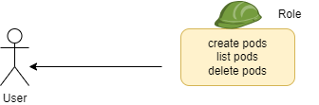
authorization
What can user or application do, is authorization ?
Imagine there is another user in cluster, and he needs to be restricted to only view pods or says storages
There are lot of authorization mechanism supported by Kubernetes
We will only visit RBAC – Role Based Access Control
RBAC consist of Role, with set of permissions
This role is then assigned to user or applications (service account)(we will see later)
py-docker-kubernetes-learnings\kubernetes_demo\access\rbac\user_access\roles
Roles and Role Bindings are at namespace level. The permissions will be assigned at namespace level
There are resources like persistent volumes, storages, which are not bound to namespaces
These resources are cluster wide
Cluster wide permissions are handled via ClusterRole and ClusterRoleBinding
py-docker-kubernetes-learnings\kubernetes_demo\access\rbac\user_access\clusterroles

Slide 87
Service accounts
User interact with kubernetes with kubectl command
Internally these will make call to kube-apiserver and fetch the results
The user is authorized with credentials available at .kube/config
Pods may also require to communicate with cluster. There are certain monitoring tools like Prometheus which need results from kubernetes APIs by accessing those
How do pod access kubernetes APIs ? It uses ServiceAccount
ServiceAccount is made for application to access kube-apiserver
Each pod got a default ServiceAccount, but default ServiceAccount have very limited permissions
As user can be bound to role, likewise service account can also be bound to role, assigning it set of permissions, thus authorizing to perform set of allowed actions
py-docker-kubernetes-learnings\kubernetes_demo\access\rbac\serviceaccounts
Notes:
Follow
https://cmakkaya.medium.com/kubernetes-creating-and-testing-a-horizontal-pod-autoscaling-hpa-in-kubernetes-cluster-548f2378f0c3

Slide 88
TEST
Try solving by referring kubernetes documentaion

Slide 89
TEST
# 1)
# Create an apache web server with following instructions
# apache server runs on PORT 80
# The apache server can be installed with following commands
# yum update -y and yum install -y httpd
# apache should serve content from index.html
# apache serve index.html from /var/www/html/
# the ENTRYPOINT will be /usr/sbin/httpd -D FOREGROUND
# the container should have user specified name
# the application should display message "Hello DevOps Team, Welcome"
# 2)
# Test changing the display message without rebuilding the image
Notes:
Follow
https://cmakkaya.medium.com/kubernetes-creating-and-testing-a-horizontal-pod-autoscaling-hpa-in-kubernetes-cluster-548f2378f0c3

Slide 90
TEST
# 3)
# create pod of same image with labels app=apache and tier=frontend
# 4)
# keep the pod running created in step #3
# create replicaset for the same, and ensure 4 copies are running
# 5)
# You need to have deployment, replicaset and pods in test_k namespace with 2 replicas
# scale up the pod to 4 replicas in Imperative way
# From hereonwards, you should be creating all artifacts in test_k namespace , so ensure you are in test_k namespace AND
# you should get pods with kubectl get pods command without specifying namespace
Notes:
Follow
https://cmakkaya.medium.com/kubernetes-creating-and-testing-a-horizontal-pod-autoscaling-hpa-in-kubernetes-cluster-548f2378f0c3

Slide 91
TEST
# 6)
# delete all the kubernetes artifacts
# 7)
# Create the same pod on each of the node
# 8)
# Change the display message to"Hello DevOps Team, Welcome to Cloud Session"
# recreate all the pods
# 9)
# create pod and login to pod with non root user, with and without changing docker image
Notes:
Follow
https://cmakkaya.medium.com/kubernetes-creating-and-testing-a-horizontal-pod-autoscaling-hpa-in-kubernetes-cluster-548f2378f0c3

Slide 92
TEST
# 10)
# Pod might need max 256Mi and 2 vCPUs. The request should be same
# Create the pod accordingly
# 11)
# Create a new pod, which should go to node02, but all other pods from node02 should get evicted
# 12)
# Create a pod, which should get bind to volume of 1G. You need to only create PVC
# 13)
# Try creating user with your name
# this user should be able to list, get, create, delete StatefulSet in test_k namespace
# verify the same
Notes:
Follow
https://cmakkaya.medium.com/kubernetes-creating-and-testing-a-horizontal-pod-autoscaling-hpa-in-kubernetes-cluster-548f2378f0c3

Slide 93
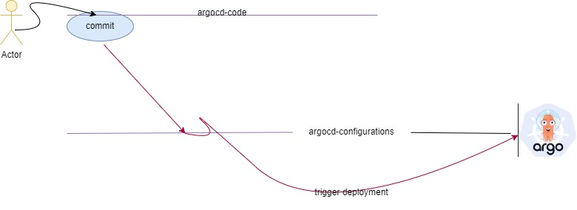
TEST
# 14)
# assignment is explained in next slide, but following picture depicts the assignment flow
# argocd application is configured with argocd-configurations git repo
# user make changes in arcocd-code repo, and that should trigger K8 deployment
Notes:
Follow
https://cmakkaya.medium.com/kubernetes-creating-and-testing-a-horizontal-pod-autoscaling-hpa-in-kubernetes-cluster-548f2378f0c3

Slide 94
TEST
# 14)
# complex assignment, you need to review every file very carefully. Intentional mistakes are incorporated in files. To run application successfully you need to correct those
# create argocd-configurations repository with admin branch
# copy applicationsets folder from classroom session of argocd
# create argocd-code repository with developer branch
# copy argocd-code-files folder’s content to argocd-code repository
# run argocd on 8082 port and over the argo UI, create argocd application with argocd-configurations repository
# create project argo-learnings and do all required steps to bring up the application
# now change replicas of nginx deployment in argocd-code repository and the argocd application should trigger deployment with changed replicas. Verify the same on argocd UI (may want to do hard refresh on argo UI)
# the build_code.sh script got required code to make this happen, you need to use this script. To use this script, review carefully all the files in code provided
Notes:
Follow
https://cmakkaya.medium.com/kubernetes-creating-and-testing-a-horizontal-pod-autoscaling-hpa-in-kubernetes-cluster-548f2378f0c3

Slide 95
Further learning
Secrets and Config Maps as volumes, Security Context Capabilities
Metrics Server
Read about Kubernetes curl APIs
Try to read about Cloud provider kubernetes services (EKS, AKS)
Try to read about Openshift

Slide 96
SUMMARY
We learnt basic features of Kubernetes.
But there is lot to kubernetes, which users can learn. New additions keep happening to this orchestration tool and user should keep himself updated.
Openshift is a tool by RedHat and make operating Kubernetes easier. User can learn about Openshift.

